Slide 1
Web Components
DAIMLER AG

Slide 2
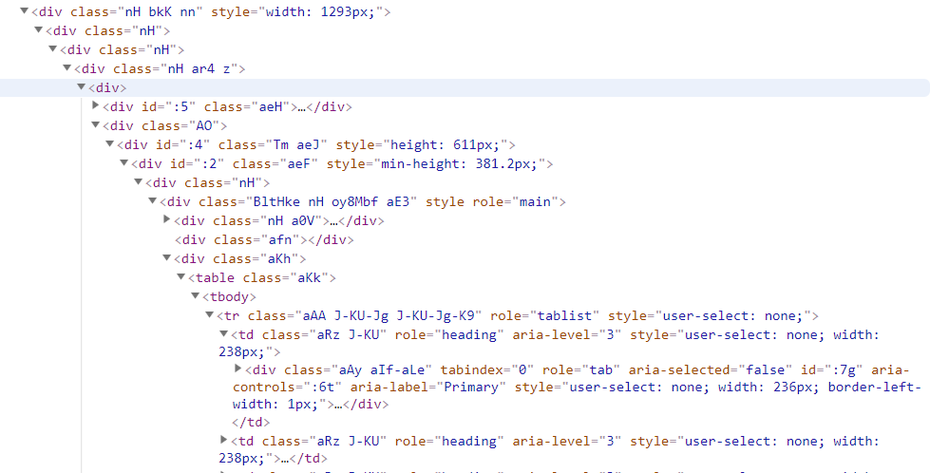


Slide 3

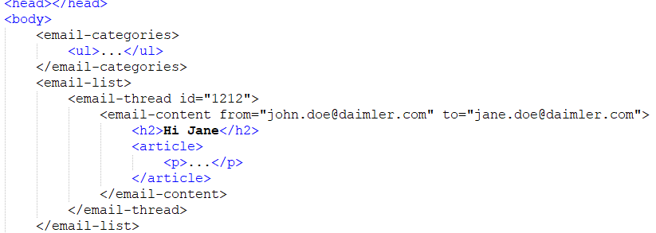
Notes:
Easier to read for devs
Makes sense elements

Slide 4
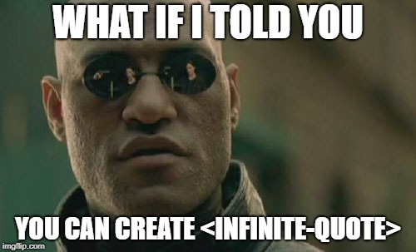

Slide 5
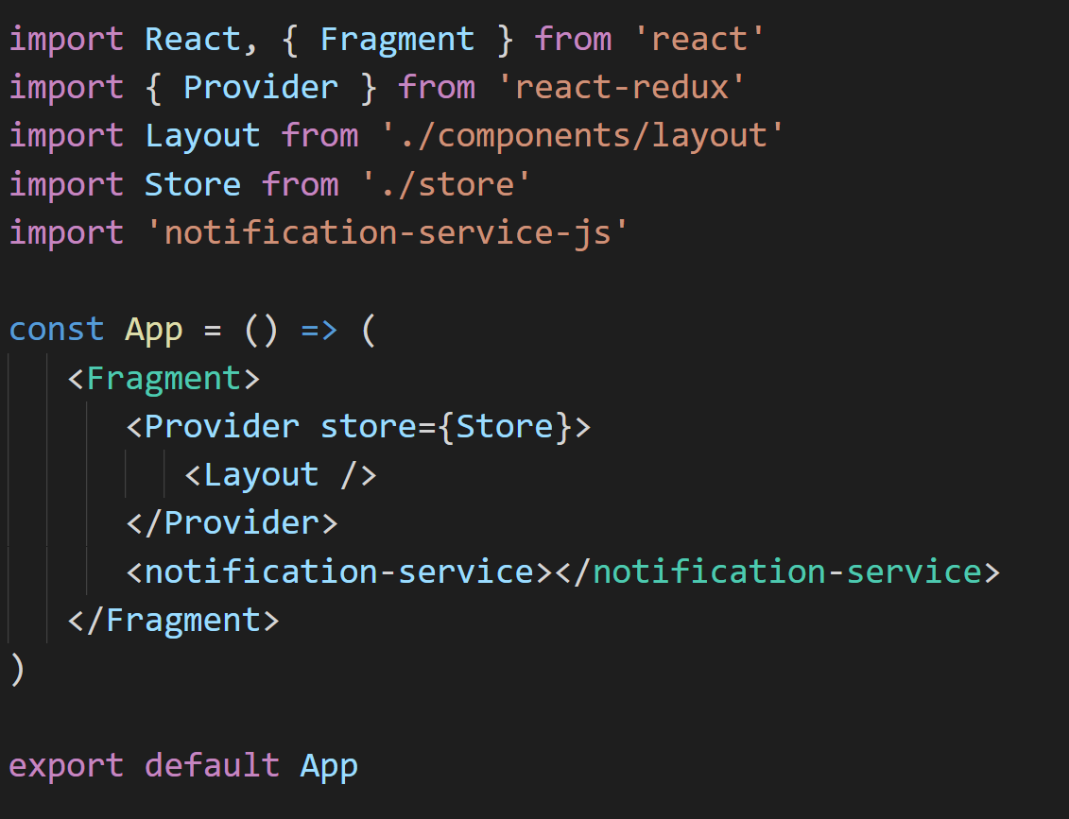

Slide 6
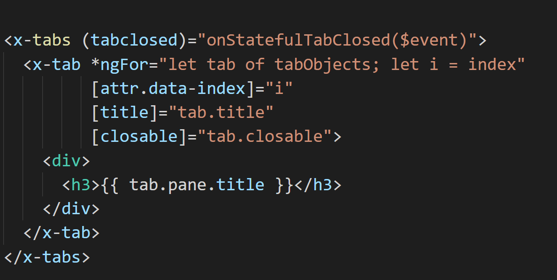

Slide 7

Web Components
https://www.webcomponents.org/

Slide 8
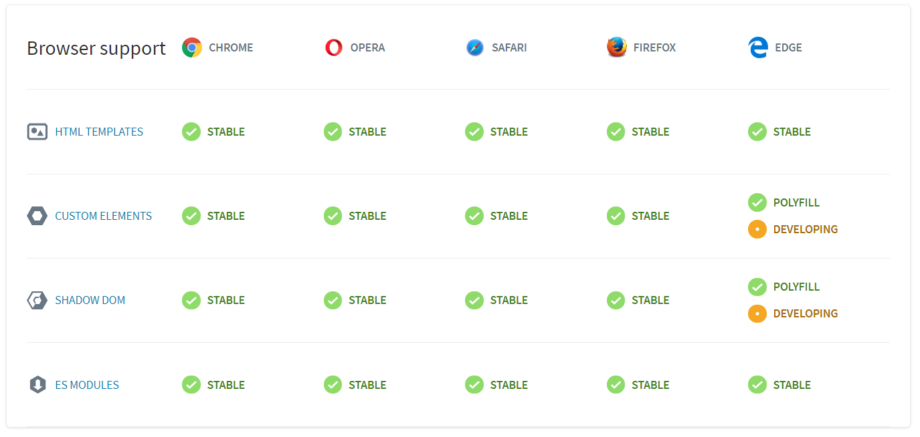

Slide 9

S
C
B

Slide 10
S
CUSTOM ELEMENTS
SHADOW
DOM
C
B
B HTML
TEMPLATES

Slide 11
Web Components - DEMO
DAIMLER AG

